Slide 1


Hii, Iam Siddhika
Welcome to Power BI Series
Part -11

Slide 2

Today Content
Are you ready guys?
continuing with
CREATING A DATA MODEL
CREATING TABLE RELATIONSHIPS MANAGING &EDITING RELATIONSHIPS STAR SCHEMA &
SNOWFLAKE SCHEMA

Slide 3
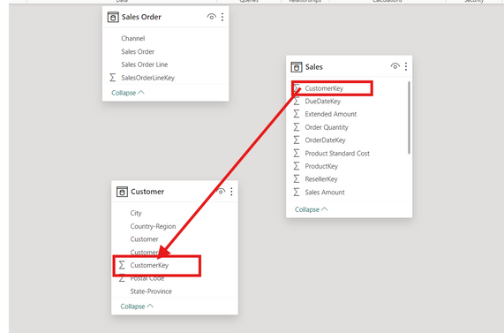

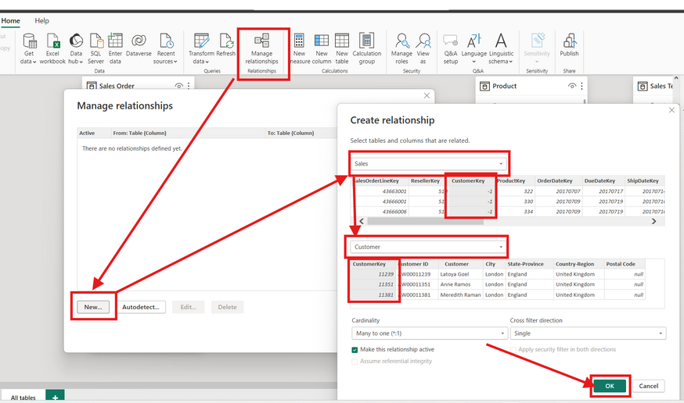
OPTION 1:
Click and drag to connect primary and foreign keys within the Model view
CREATING TABLE RELATIONSHIPS
Have you created?
OPTION 2: Add
or detect relationships using the Manage Relationships dialog box

Slide 4
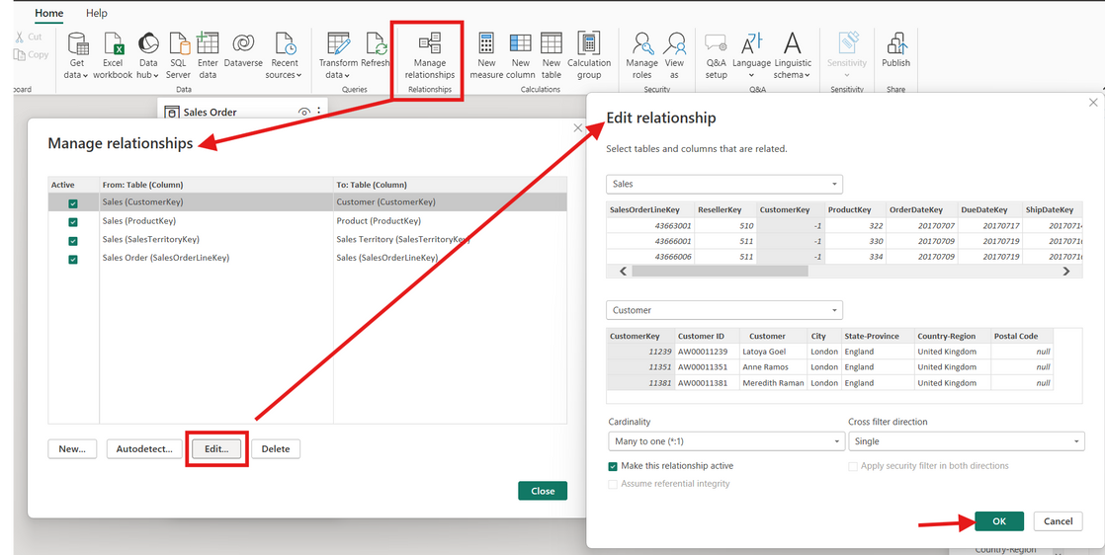

MANAGING &EDITING RELATIONSHIPS
check this
Launch the Manage Relationships dialog box or double-click a relationship to modify it
Editing tools allow you to activate or deactivate relationships and manage cardinality and filter direction.

Slide 5
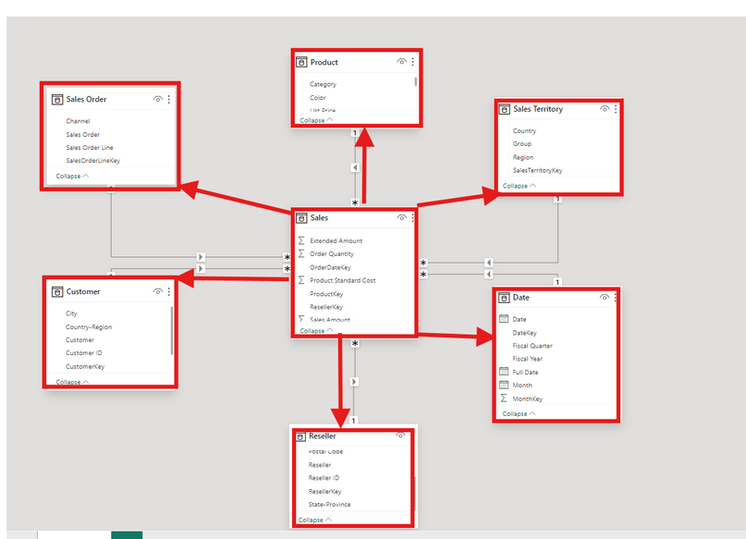

STAR SCHEMA
Have got it?
A star schema is the simplest and most common type of data model, characterized by a single fact table surrounded by related dimension tables

Slide 6
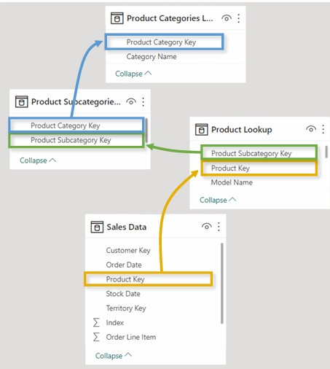

SNOWFLAKE SCHEMA
Which schema are you used?
A snowflake schema is an extension of a star, and includes relationships between dimension tables and related sub- dimension tables

